Slide 1
Introduction to Convection:
Flow and Thermal Considerations
Chapter Six and Appendix E
Sections 6.1 to 6.9 and E.1 to E.3

Slide 2
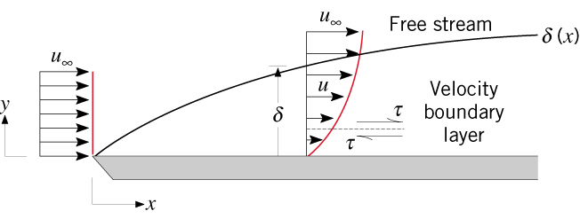


Boundary Layer Features
Boundary Layers: Physical Features
Velocity Boundary Layer
A consequence of viscous effects
associated with relative motion
between a fluid and a surface.
A region of the flow characterized by
shear stresses and velocity gradients.
A region between the surface
and the free stream whose
thickness increases in
the flow direction.
Why does increase in the flow direction?
Manifested by a surface shear
stress that provides a drag
force, .
How does vary in the flow
direction? Why?

Slide 3
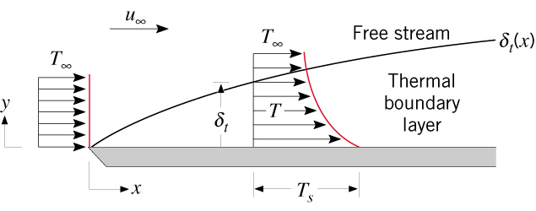


Boundary Layer Features (cont.)
Thermal Boundary Layer
A consequence of heat transfer
between the surface and fluid.
A region of the flow characterized
by temperature gradients and heat
fluxes.
A region between the surface and
the free stream whose thickness
increases in the flow direction.
Why does increase in the
flow direction?
Manifested by a surface heat
flux and a convection heat
transfer coefficient h .
If is constant, how do and
h vary in the flow direction?

Slide 4
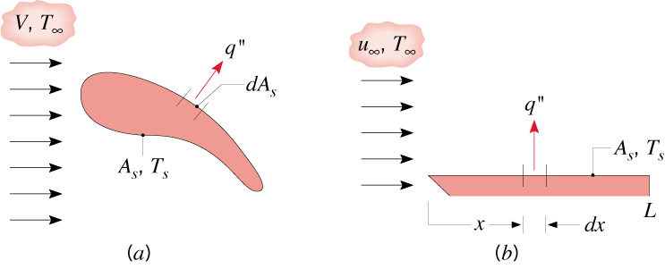
Local and Average Coefficients
Distinction between Local and
Average Heat Transfer Coefficients
Local Heat Flux and Coefficient:
Average Heat Flux and Coefficient for a Uniform Surface Temperature:
For a flat plate in parallel flow:

Slide 5
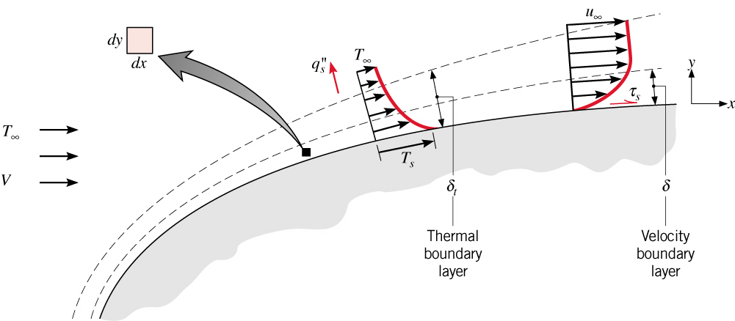
Boundary Layer Equations
The Boundary Layer Equations
Consider concurrent velocity and thermal boundary layer development for steady,
two-dimensional, incompressible flow with constant fluid properties and
negligible body forces.
Apply conservation of mass, Newton’s 2nd Law of Motion and conservation of energy
to a differential control volume and invoke the boundary layer approximations.
Velocity Boundary Layer:
Thermal Boundary Layer:

Slide 6

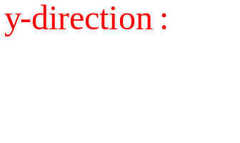
Boundary Layer Equations (cont.)
Conservation of Mass:
In the context of flow through a differential control volume, what is the physical
significance of the foregoing terms, if each is multiplied by the mass density of
the fluid?
Newton’s Second Law of Motion:
What is the physical significance of each term in the foregoing equation?
Why can we express the pressure gradient as dp/dx instead of

Slide 7
Boundary Layer Equations (cont.)
Conservation of Energy:
What is the physical significance of each term in the foregoing equation?
What is the second term on the right-hand side called and under what conditions
may it be neglected?

Slide 8
Similarity Considerations
Boundary Layer Similarity
As applied to the boundary layers, the principle of similitude is based on
determining similarity parameters that facilitate application of results obtained
for a surface experiencing one set of conditions to geometrically similar surfaces
experiencing different conditions. (Recall how introduction of the similarity
parameters Bi and Fo permitted generalization of results for transient, one-
dimensional condition).
Dependent boundary layer variables of interest are:
For a prescribed geometry, the corresponding independent variables are:
Geometrical: Size (L), Location (x,y)
Hydrodynamic: Velocity (V)
Fluid Properties:

Slide 9
Similarity Considerations (cont.)
Key similarity parameters may be inferred by non-dimensionalizing the momentum
and energy equations.
Recast the boundary layer equations by introducing dimensionless forms of the
independent and dependent variables.
Neglecting viscous dissipation, the following normalized forms of the x-momentum
and energy equations are obtained:

Slide 10

Similarity Considerations (cont.)
How may the Reynolds and Prandtl numbers be interpreted physically?
For a prescribed geometry,
The dimensionless shear stress, or local friction coefficient, is then
What is the functional dependence of the average friction coefficient, C_{f} ?

Slide 11
Similarity Considerations (cont.)
For a prescribed geometry,
The dimensionless local convection coefficient is then
What is the functional dependence of the average Nusselt number?
How does the Nusselt number differ from the Biot number?

Slide 12
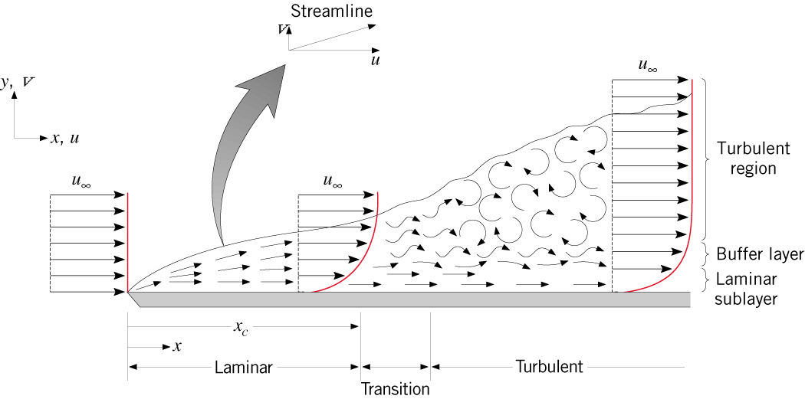

Transition
Boundary Layer Transition
How would you characterize conditions in the laminar region of boundary layer
development?
In the turbulent region?
What conditions are associated with transition from laminar to turbulent flow?
Why is the Reynolds number an appropriate parameter for quantifying transition
from laminar to turbulent flow?
Transition criterion for a flat plate in parallel flow:

Slide 13
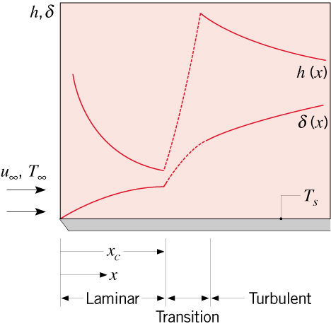
Transition (cont.)
What may be said about transition if Re_{L} < Re_{x,c}?
If Re_{L} > Re_{x,c}?
Effect of transition on boundary layer thickness and local convection coefficient:
Why does transition provide a significant increase in the boundary layer thickness?
Why does the convection coefficient decay in the laminar region?
Why does it increase
significantly with transition to turbulence, despite the increase in the boundary layer
thickness?
Why does the convection coefficient decay in the turbulent region?

Slide 14
Reynolds Analogy
The Reynolds Analogy
Equivalence of dimensionless momentum and energy equations for
negligible pressure gradient (dp*/dx*~0) and Pr~1:
Advection terms
Diffusion
Hence, for equivalent boundary conditions, the solutions are of the same form:

Slide 15

Reynolds Analogy (cont.)
With Pr = 1, the Reynolds analogy, which relates important parameters of the velocity
and thermal boundary layers, is
Modified Reynolds (Chilton-Colburn) Analogy:
An empirical result that extends applicability of the Reynolds analogy:
Colburn j factor for heat transfer
Applicable to laminar flow if dp*/dx* ~ 0.
Generally applicable to turbulent flow without restriction on dp*/dx*.

Slide 16
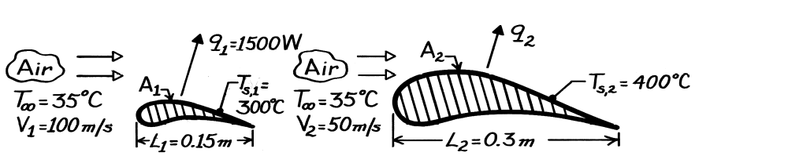
Problem: Turbine Blade Scaling
Problem 6.28: Determination of heat transfer rate for prescribed turbine blade operating conditions from wind tunnel data obtained for a geometrically similar but smaller blade. The blade surface area may be assumed to be directly proportional to its characteristic length .

Slide 17
Problem: Turbine Blade Scaling (cont.)

Slide 18
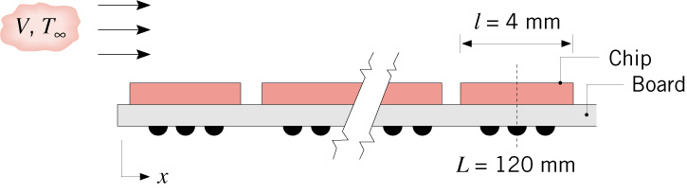
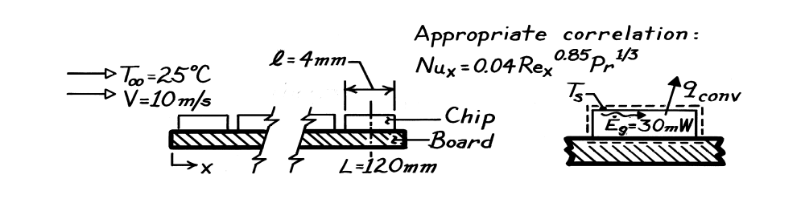
Problem: Nusselt Number
Problem 6.35: Use of a local Nusselt number correlation to estimate the
surface temperature of a chip on a circuit board.

Slide 19
Problem: Nusslet Number (cont.)

Slide 20
Problem: Nusslet Number (cont.)

